Slide 1
Probe Data Analysis for Road Slope

Slide 2
1. ABSTRACT
2. INTRODUCTION
3. RELATED WORK
4. SYSTEM OVERVIEW
5. The MATCHING ALGORITHM
6. CALCULATE SLOPE
7. EVALUATE THE DERIVED SLOPE
8. CONCLUSION
Map-matching is the process of aligning a sequence of observed user positions with the road network on a digital map. In practice there exists huge amount of low-sampling-rate (e.g., one point every 2-5 minutes) GPS trajectories.
we propose a novel global map matching algorithm called ST-Matching for low sampling rate GPS trajectories. ST-Matching considers the spatial geometric and topological structures of the road network and the temporal/speed constraints of the trajectories.

Slide 3
1. ABSTRACT
2. INTRODUCTION
3. RELATED WORK
4. SYSTEM OVERVIEW
5. The MATCHING ALGORITHM
6. CALCULATE SLOPE
7. EVALUATE THE DERIVED SLOPE
8. CONCLUSION
Typically a GPS trajectory is not precise due to measurement errors caused by the limitation of GPS devices and sampling error caused by the sampling rate.
For an approach that only considers current positions, the result is greatly affected by measurement errors.
We addresses the problem of sampling error in particular.

Slide 4
1. ABSTRACT
2. INTRODUCTION
3. RELATED WORK
4. SYSTEM OVERVIEW
5. The MATCHING ALGORITHM
6. CALCULATE SLOPE
7. EVALUATE THE DERIVED SLOPE
8. CONCLUSION
Key to addresses the problem of sampling error:
Observation 1: True paths tend to be direct, rather than roundabout.
Observation 2: True paths tend to follow the speed constraints of the road.

Slide 5
1. ABSTRACT
2. INTRODUCTION
3. RELATED WORK
4. SYSTEM OVERVIEW
5. The MATCHING ALGORITHM
6. CALCULATE SLOPE
7. EVALUATE THE DERIVED SLOPE
8. CONCLUSION
We make the following contributions:
1. We propose a novel global matching algorithm called ST-matching for low-sampling-rate GPS trajectories.
2. We perform extensive experiments on both synthetic and real dataset.
3. Our algorithm is evaluated in terms of running time and matching accuracy.

Slide 6
1. ABSTRACT
2. INTRODUCTION
3. RELATED WORK
4. SYSTEM OVERVIEW
5. The MATCHING ALGORITHM
6. CALCULATE SLOPE
7. EVALUATE THE DERIVED SLOPE
8. CONCLUSION
Map-matching Problem
local/incremental method: using distance similarity and orientation similarity to evaluate the candidate edges. When the sampling rate decreases, the accuracy degrades.
global method: aim to match the entire trajectory with the road network. Meanwhile, the temporal/speed information in the trajectories is generally overlooked.

Slide 7
1. ABSTRACT
2. INTRODUCTION
3. RELATED WORK
4. SYSTEM OVERVIEW
5. The MATCHING ALGORITHM
6. CALCULATE SLOPE
7. EVALUATE THE DERIVED SLOPE
8. CONCLUSION
Shortest Path Computation
Calculate the distances from the probe points to the reference nodes. Find out the shortest perpendicular distance
The basic algorithm in shortest path computation is Dijkstra's algorithm.

Slide 8
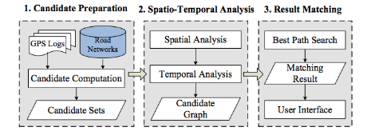
1. ABSTRACT
2. INTRODUCTION
3. RELATED WORK
4. SYSTEM OVERVIEW
5. The MATCHING ALGORITHM
6. CALCULATE SLOPE
7. EVALUATE THE DERIVED SLOPE
8. CONCLUSION
SYSTEM OVERVIEW
Candidate Preparation: contains a road network database with indexed edge and vertex information.
Spatial Analysis: performs spatial analysis followed by temporal analysis on the retrieved candidate sets and the trajectory to be matched.
Result Matching: evaluates the candidate graph using the weight information assigned during spatial/temporal analysis.

Slide 9
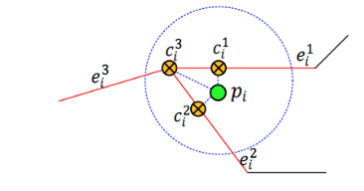
1. ABSTRACT
2. INTRODUCTION
3. RELATED WORK
4. SYSTEM OVERVIEW
5. The MATCHING ALGORITHM
6. CALCULATE SLOPE
7. EVALUATE THE DERIVED SLOPE
8. CONCLUSION
Candidate Preparation
we use 𝑒𝑖 𝑗 and 𝑐𝑖 𝑗 respectively to denote the 𝑗th candidate edge and candidate point of 𝑝𝑖 . 𝑝𝑖 ‟s candidate points are 𝑐𝑖 1 ,𝑐𝑖 2 and 𝑐𝑖 3

Slide 10


1. ABSTRACT
2. INTRODUCTION
3. RELATED WORK
4. SYSTEM OVERVIEW
5. The MATCHING ALGORITHM
6. CALCULATE SLOPE
7. EVALUATE THE DERIVED SLOPE
8. CONCLUSION
Spatial Analysis
Use both geometric and topological information of the road network to evaluate the candidate points found in the previous step
The spatial analysis function 𝐹𝑠 𝑐𝑖−1 𝑡 → 𝑐𝑖 𝑠 as the product of observation probability and transmission probability is:

Slide 11
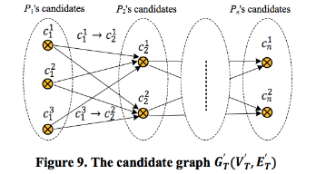
1. ABSTRACT
2. INTRODUCTION
3. RELATED WORK
4. SYSTEM OVERVIEW
5. The MATCHING ALGORITHM
6. CALCULATE SLOPE
7. EVALUATE THE DERIVED SLOPE
8. CONCLUSION
Result Matching
We are able to generate a candidate graph 𝐺𝑇 ′ (𝑉𝑇 ′ , 𝐸𝑇 ′ ) for trajectory 𝑇: 𝑝1 → 𝑝2 → ⋯ → 𝑝𝑛 . 𝑉𝑇 ′ is a set of candidate points for each GPS sampling point, and 𝐸𝑇 ′ is a set of edges representing the shortest paths between any two neighboring candidate points, as depicted in Figure 9. Each node in 𝐺 ′ is associated with 𝑁 𝑐𝑖 𝑠 . Each edge is associated with 𝑉 𝑐𝑖−1 𝑡 → 𝑐𝑖 𝑠 and 𝐹𝑡 𝑐𝑖−1 𝑡 → 𝑐𝑖 𝑠 .

Slide 12
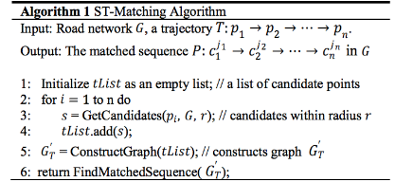
1. ABSTRACT
2. INTRODUCTION
3. RELATED WORK
4. SYSTEM OVERVIEW
5. The MATCHING ALGORITHM
6. CALCULATE SLOPE
7. EVALUATE THE DERIVED SLOPE
8. CONCLUSION
Algorithm 1 Matching
We first compute the candidate point sets for each GPS sampling point on 𝑇. Then we construct the candidate graph 𝐺𝑇 ′ (𝑉𝑇 ′ ,𝐸𝑇 ′ ) based on spatial and temporal analysis. Finally, the algorithm reports the path sequence 𝑃 with highest ST-function value from 𝐺𝑇 ′ as the result.

Slide 13
1. ABSTRACT
2. INTRODUCTION
3. RELATED WORK
4. SYSTEM OVERVIEW
5. The MATCHING ALGORITHM
6. CALCULATE SLOPE
7. EVALUATE THE DERIVED SLOPE
8. CONCLUSION
Algorithm 2 Find-Matched-Sequence
The Find-Matched-Sequence procedure aims to find the longest path in 𝐺𝑇 ′ . In general, finding longest path in a graph is an NPC problem.
However, 𝐺𝑇 ′ is a directed acyclic graph (DAG) and the answer can be computed efficiently using the topological order of the graph. It is easy to see that such topological order can be obtained from the construction of 𝐺𝑇 ′ . Algorithm 2 shows the details of the procedure Find-Matched-Sequence.

Slide 14
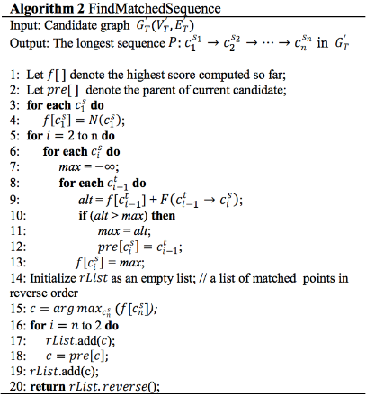
1. ABSTRACT
2. INTRODUCTION
3. RELATED WORK
4. SYSTEM OVERVIEW
5. The MATCHING ALGORITHM
6. CALCULATE SLOPE
7. EVALUATE THE DERIVED SLOPE
8. CONCLUSION

Slide 15
1. ABSTRACT
2. INTRODUCTION
3. RELATED WORK
4. SYSTEM OVERVIEW
5. The MATCHING ALGORITHM
6. CALCULATE SLOPE
7. EVALUATE THE DERIVED SLOPE
8. CONCLUSION
Data:
Latitude, longitude and altitude of the matched points
Method:
Step 1: Pair up the matched points with the same LinkPVID
Step 2: Calculate the distance between each pair of points
Step 3: Calculate the altitude between each pair of points
Step 4: Calculate the angle of the slope by using sine function
Step 5: Evaluate the derived road slope with the surveyed road slope in the link data file

Slide 16

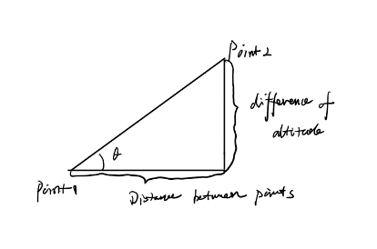
1. ABSTRACT
2. INTRODUCTION
3. RELATED WORK
4. SYSTEM OVERVIEW
5. The MATCHING ALGORITHM
6. CALCULATE SLOPE
7. EVALUATE THE DERIVED SLOPE
8. CONCLUSION
Formula:

Slide 17
1. ABSTRACT
2. INTRODUCTION
3. RELATED WORK
4. SYSTEM OVERVIEW
5. The MATCHING ALGORITHM
6. CALCULATE SLOPE
7. EVALUATE THE DERIVED SLOPE
8. CONCLUSION
Evaluate the Derived slopes with surveyed road slopes in Link data:
1.Extract latitude and longitude of each point of the matching pair.
2.Convert each latitude and longitude from degree to meter.
3.Calculate the distance between each matching pair by using the distance equation.
4.Calculate the altitude between each pair by subtracting the elevation of each point.
5.Use the since function to calculate the angle of the slope.
6.Evaluate the slope.

Slide 18
1. ABSTRACT
2. INTRODUCTION
3. RELATED WORK
4. SYSTEM OVERVIEW
5. The MATCHING ALGORITHM
6. CALCULATE SLOPE
7. EVALUATE THE DERIVED SLOPE
8. CONCLUSION
The surveyed road slope:
Latitude 53.06503
Longitude 8.79147
Slope 0.062
The calculated result:
Latitude 53.06503
Longitude 8.79147
Slope -0.01138

Slide 19
1. ABSTRACT
2. INTRODUCTION
3. RELATED WORK
4. SYSTEM OVERVIEW
5. The MATCHING ALGORITHM
6. CALCULATE SLOPE
7. EVALUATE THE DERIVED SLOPE
8. CONCLUSION
Conclusion
1: We use the first node of shapInfo to be the refNode, but it may cause some minor deviation.
2: There are so many data in the dataset, and it will cost too much time to calculate all of them. So we only use 5000 rows of data.
3: There may be more than two nodes on the same link, so we probably get a different result when we get two different nodes.
4: There are some redundant data which may cause the result not very accuracy and large.

Slide 20
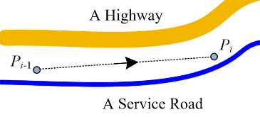
1. ABSTRACT
2. INTRODUCTION
3. RELATED WORK
4. SYSTEM OVERVIEW
5. The MATCHING ALGORITHM
6. CALCULATE SLOPE
7. EVALUATE THE DERIVED SLOPE
8. CONCLUSION
Drawbacks
There are situations that spatial analysis alone could not handle.
The spatial analysis function may produce the same value matched to the highway or the service road.
However, if we calculate the average speed from 𝑝𝑖−1 to 𝑝𝑖 as 80km/h , we would match them to the highway considering the speed limits of the service road.

Slide 21
1. ABSTRACT
2. INTRODUCTION
3. RELATED WORK
4. SYSTEM OVERVIEW
5. The MATCHING ALGORITHM
6. CALCULATE SLOPE
7. EVALUATE THE DERIVED SLOPE
8. CONCLUSION
Reference
2009 Sigspatial
Map-Matching for Low-Sampling-Rate GPS Trajectories
http://research.microsoft.com/apps/pubs/default.aspx?id=105051Â (Links to an external site.)

Slide 22
Thank you!

